Slide 1
Coursera CAPSTONE
Yoga Studio vs Gym

Slide 2
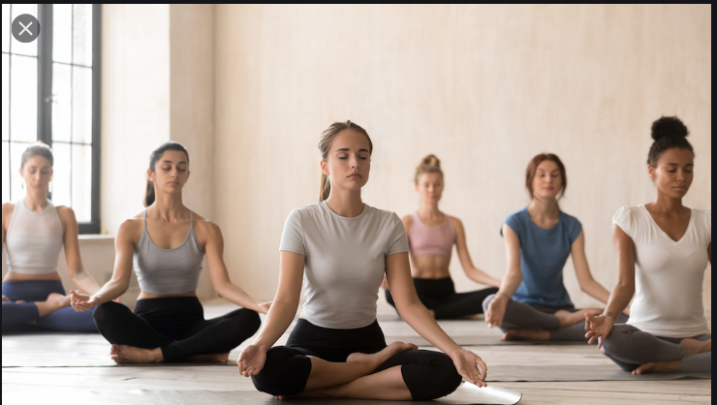
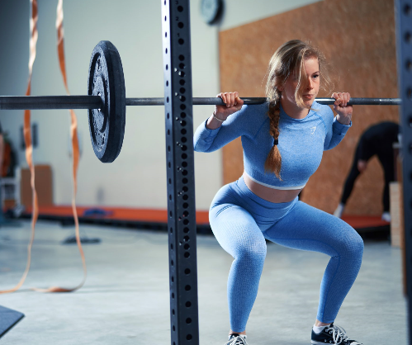
Introduction - Business problem¶
The business problem is basically answering the question of where should I invest my savings opening a Gym.
The general feeling is that people that practice Yoga are "fitness junkies" and therefore practice both Yoga and Gym if they have the chance.
Wherever there is a Yoga Studio, there is a market for a Gym
I will analyze this in my region to find the BEST LOCATION to open Gym

Slide 3
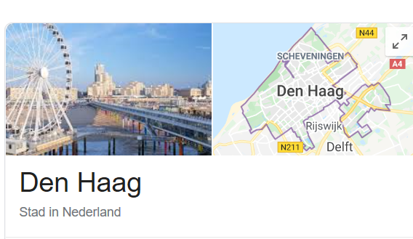

Data
I will collect data from the different Yoga Studios and Gyms in the regions around my house.
And I will check whether there is any place where we have a Yoga Studio but not a Gym around.
Methodology
I extracted from FourSquare data from both Gym and Yoga Studios in the greater the Hague region.
I plotted both types of business in a map of the region and I checked whether a pattern aroused.
This pattern was clear.
However a more analytical approach cauterizing the business by region would allow me to understand whether
the first conclusion is valid. The number of cluster was taken from the visual approach above.
The conclusion expressed below clearly indicates the places where there are no Gyms, but we do see Yoga Studios

Slide 4
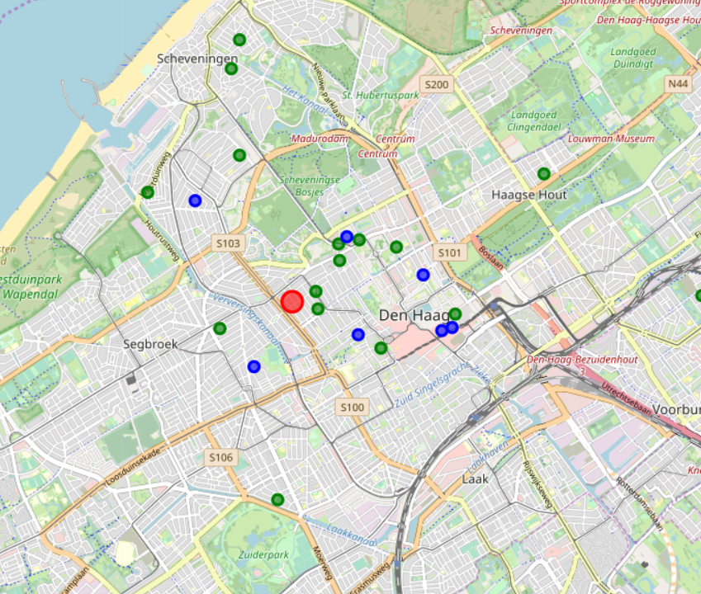
Visual representation The map shows the Yoga Studios in blue and the Gyms in green

Slide 5
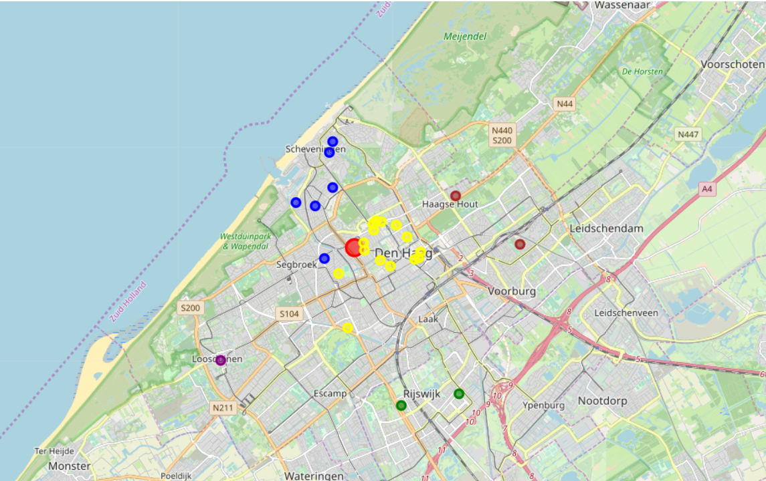
Analytical Study – Clusters in map
We divide the city 5 clusters
The map is clearly clustering the areas by neighborhoods:
Cluster 0 is Sergbroek and Scheveningen
Cluster 1 is City Centre
Cluster 2 is Leidschendam and Haagse Hout
Cluster 3 is Rijkskwijk
Cluster 4 is Loosdouinen

Slide 6
Analytical Study – clusters in tables
Cluster | # of Yoga Studios | # of Gyms
Sergbroek and Scheveningen | 5 | 1
City Centre | 9 | 6
Leidschendam and Haagse Hout | 2 | 0
Rijkskwijk | 2 | 0
Loosdouinen | 1 | 0

Slide 7
Results
We can clearly see in the second map that close to my house (marked in red) in the City Centre Neighborhood there is a strong correlation between Yoga studios In the table above we see there are gyms and Yoga Studios (6 and 9 respectively) In the area of Sergebroek and Scheveningen there are also Gyms and Yoga Studios (5 and 1 respectively)
However, the areas farther away like Rijkskwik (cluster 3 -green) and Loosduinen (cluster 4 - purple) have only Gyms (2 and 1 as per table above)
By using economic studies like price of houses and tax info we know that the area of Rijswijk has a high economic power has a Yoga studio but not Gym.
Discussion
Seeing the results above expressed, my recommendation is to open a Gym in Rijkswik Conclusion section where you conclude the report. I would invest in a Yoga studio in the area of Rijkswijk
Conclusion
I would invest in a Yoga studio in the area of Rijkswijk

